Slide 1
Tamaclone
Team Members: Aidan McArthur, Bryan Kuo, Mark Oakeson, Jared Malooly

Slide 2

The Big Thing
This was actually my third idea regarding the actual screen of the Tamagotchi. We ended up implementing this “hotswapping” idea by switching the selected pane on update. The “screen pane” can be the current state of the screen--menu, game, animations, these all fit on the screenpane. On update, the view would ask the model (who in turn is told by the controller) which pane is the current screen and replace it on the root pane.

Slide 3
Observable
Each screenpane instance implements Observer. This is crucial to the effectiveness of the screenpane idea because in a way, these are simply separate views. Or rather, a small replaceable puzzle piece. They update on button presses on their own. They only talk to the controller, however, the backend is still very much the backend--where all the real work happens.

Slide 4

Modularity
By hot swapping panes on the view, we came up with a sort of modular system of creating game states. The menuPane is separate from the gamePane, for example. I believe this cut down on the overall workload of the project as a whole, as it effectively split up the work into more manageable chunks. This is what object oriented programming is all about, isn’t it?

Slide 5
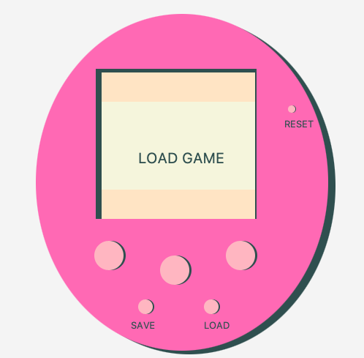
Buttons
The unlabeled buttons are familiar to the original tamagotchi. Button 1 advanced the menu, while button 2 selects. The third goes backward, reverse of the 1st.
The save and load buttons create and read a unique .sav file respectively.
Finally, the reset button brings you back to the main menu.

Slide 6
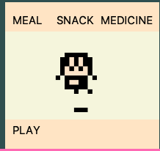
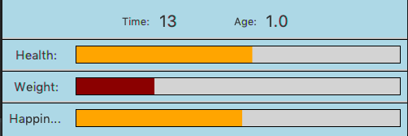
Caring for Tama
Feed, give medicine to, and play with the tamagotchi, but pay attention to the stat bars. It will die if they get too low.

Slide 7
Animation
Tama is completely animated, up until death, anyway

